Slide 1
Unit 5 Applications of IT and E Commerce
Lecture 4

Slide 2
Business Intelligence (BI)
BI refers to the ability of an organization to handle and process data with a view of providing its decision makers with insight into organization activities.
Required for following purposes:
to find out how the actual performance of an organizations compare with its set goals.
For eg. In retail shops for customer profiting to issue credit/gift coupons to privileged customers.
In manufacturing firms for ordering shipment and customer support.
In financial services for claims analysis and fraud detection.
In transportation companies for fleet management.
In telecommunication sector for identifying customer churn.

Slide 3
BI Technologies
Simple decision support tools like a spreadsheet.
Data warehousing tools that help in preparing data for analysis. Data preparation involves data extraction , data transformation and data loading.
Data mining tools that helps in analyzing data in various ways to reveals pattern and new knowledge that helps for decision making.
Big data Analytic tools that are large in volume which is beyond the ability of common software tools.
Data Visualizations tools that helps for better understanding.
Other decision support tools that help in making decision of specific nature.

Slide 4
Extranet in Business
An extranet is a private network similar to an intranet, but typically open to external parties, such as business partners, suppliers, key customers etc.
The main purpose of an extranet is to allow users to exchange data and applications, and share information.
Reasons to use an extranet
An extranet can be a useful tool for the following business needs:
Using online ordering, electronic order tracking and inventory management internally or externally, with selected partners
Working flexibly to meet the demands of larger companies, by adopting new technologies and enabling the exchange of business information and transactions
Facilitating a cheap and efficient way for businesses to connect with their trading partners and suppliers, and allowing them access to the information they need 24 hours a day
Automating the trading tasks between you and your trading partners, in order to strengthen business relationships and integrate your business firmly within their supply chain

Slide 5
AI and Intelligent Agents
What is intelligence?
• Intelligence is:
– the ability to reason
– the ability to understand
– the ability to create
– the ability to Learn from experience
– the ability to plan and execute complex tasks
• Artificial:
– Made as copy something like natural.

Slide 6
What is artificial intelligence?
• Artificial Intelligence is the branch of computer science concerned with making computers behave like humans.
• John McCarthy, who coined the term in 1956, defines it as "the science and engineering of making intelligent machines, especially intelligent computer programs."

Slide 7
Intelligent agent:
– A Successful system can be called intelligent agent.
– Fundamental faculties of intelligence are: Acting, Sensing, Understanding ,Reasoning, Learning
– In order to act intelligent agent must sense.
Blind actions is not characterization of intelligence. Understanding is essential to interpret the sensory percepts and decide on an action.
– Therefore, Intelligent agent: Must act, Must sense, Must be autonomous, Must be rational.
– Note: intelligent agent means it does things based on reasoning, while rational agent means it does the best action (or reaction) for a given situation.

Slide 8
Expert Systems
An expert system is a computer system whose performance is guided by specific, expert knowledge in solving problems.
– simulates the decision- making process of a human expert in a specific domain.
– solves problems in a narrow problem area by using high-quality, specific knowledge rather than an algorithm.
– used by most of the large or medium sized organization as a major tool for improving productivity and quality.

Slide 9
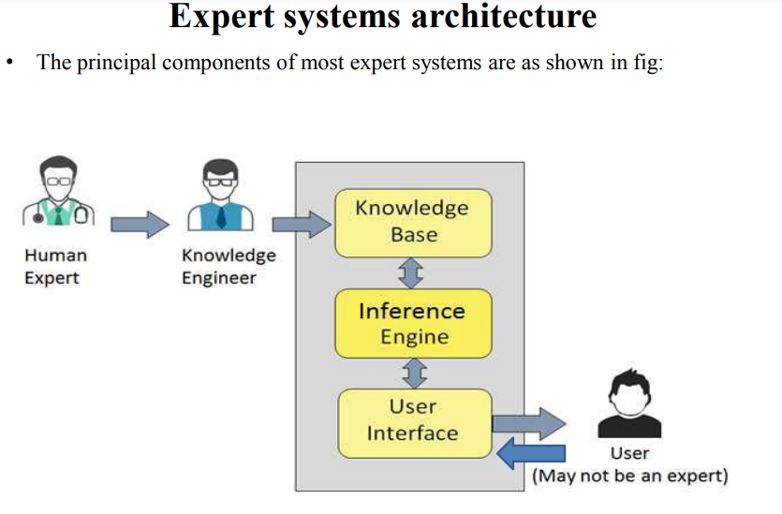

Slide 10
Fundamental characteristics of an expert system
• Useful
• Usable
• Educational when appropriate
• Explain its advice
• Respond to simple questions also
• Learn new knowledge
• Easily modifiable

Slide 11
Information Systems
Information systems are the software and hardware systems that support data-intensive applications.
Set of inter related components
Support decision making , coordination and control
Major Types of Information Systems
Transaction Processing Systems.
Office Automation Systems.
Knowledge Work Systems.
Management Information Systems.
Decision Support Systems.
Executive Support Systems.

Slide 12
Global Information management
Why Global ?
Businesses compete in global market.
Economics are closely integrated.
Cheap, plentiful communication
New markets
Advantages of outsourcing.

Slide 13
Global Competitive Environment
Business Intelligence:
Research Competition
Find Suppliers
Target customers
Greater Competition
E-Commerce
New market
Market Domination

Slide 14
Processes
Logistics
Outsourcing

Slide 15
